Slide 1

Working title: CFD and ROM of Flow over a Golf Court
Bachelor project, 2026
Meeting 5, date: 07-04-2026
GROUP 3
Eske Freiesleben
Jacob Manniche
J. Alfred Pedersen
Student ID
S234229
S234258
S230869

Slide 2
Table of contents
3: NDA - NDAs has been signed and sent to Trackman
4: Research questions – Three core and one extra research questions have been formulated
5: Structure - Structure update including our estimate of a step-by-step approach and updated GANT
6: G-bar/HPC – Status update
7: Trajectory model – Trajectory model status and demo
8-13: Structure update – Walk through of current structure for the project
Bachelor project:
CFD and ROM of Flow over a Golf Court

Slide 3
NDA
NDA’s have been sent to trackman yesterday (06-04-2026)
With the following specifications;
Tentative project title: CFD and ROM of Flow over a Golf Court
Project period: 16.03.2026 – 07.06.2026, which is twelve weeks total from the start date.
Bachelor project:
CFD and ROM of Flow over a Golf Court

Slide 4
Research questions
We have formulated the following three core research questions, along with a fourth which can be included if time allows.
What meaningful differences arise in trajectories when comparing static uniform wind fields and wind fields from RANS simulations, for standardized golf shots over flat terrain?
How do terrain features such as surface roughness, shallow hills and trees influence the wind and trajectory, including variations in wind veer?
What is the impact of varying wind conditions in a fairway corridor lined by tree lines on both sides?
Is there a meaningful impact on trajectory by including stochastic TKE-based variations to RANS simulated wind fields
Bachelor project:
CFD and ROM of Flow over a Golf Court

Slide 5
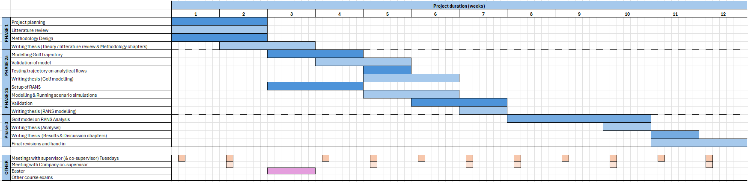
Structure update: GANTT
Updated the GANTT-diagram to reflect the new direction and this two-pronged approach with RANS and trajectory model
Bachelor project:
CFD and ROM of Flow over a Golf Court

Slide 6
G-bar/HPC update
1. From last week
We followed the guide on PyWakeEllipSys
We can log on to Gbar and start a job via sh-script
We confirmed by successfully running the native test script
2. Now
We contacted G-bar support to establish a folder on the HPC. They replied that they need the answers to the following questions before proceeding (https://www.hpc.dtu.dk/?page_id=5580):
Program(s)?
GPU’s?
Student/Course?
Storage size?
Lifetime?
Other relevant information?
Bachelor project:
CFD and ROM of Flow over a Golf Court

Slide 7
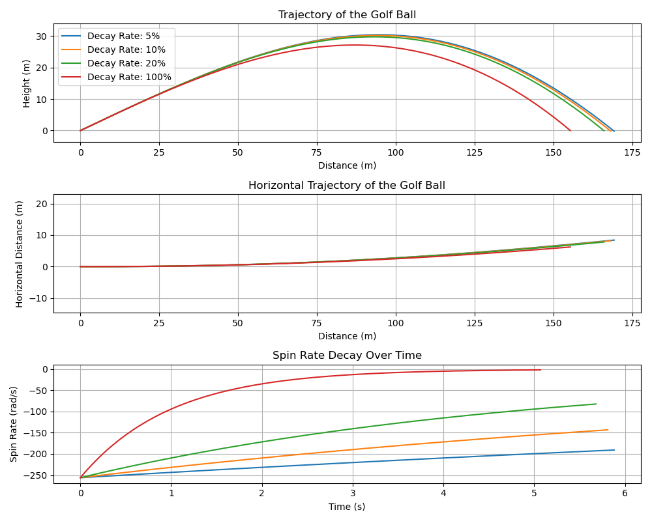
Trajectory model update
Bachelor project:
CFD and ROM of Flow over a Golf Court

Slide 8
Trajectory model update
Bachelor project:
CFD and ROM of Flow over a Golf Court

Slide 9
Structure
To achieve this, we have the following structure which we can take a closer look at:
Abstract
Preface
Acknowledgements
Introduction
Theory
Data
Modelling
Results
Analysis
Discussion
Conclusion
Exact structure of these
sections will be determined
once we get further
Bachelor project:
CFD and ROM of Flow over a Golf Court

Slide 10
Structure
To achieve this, we have the following structure which we can take a closer look at:
Abstract
Preface
Acknowledgements
Introduction
Theory
Data
Modelling
Results
Analysis
Discussion
Conclusion
2. Theory
Theoretical behavior of wind in the lower atmosphere
Atmospheric boundary layer
Shear
Turbulence
Roughness
Stability
Veer
Impact of terrain on the wind
Flow over a Gaussian Hill & flow over multiple hills (?)
Flow past and around trees (?)
Trajectory of a golf ball
Exact structure of trajectory section is still under construction
RANS theory
Bachelor project:
CFD and ROM of Flow over a Golf Court

Slide 11
Structure
To achieve this, we have the following structure which we can take a closer look at:
Abstract
Preface
Acknowledgements
Introduction
Theory
Data
Modelling
Results
Analysis
Discussion
Conclusion
3. Data
Terrain cases
Flat terrain (varying roughness)
Terrain with hill or ridge (varying height/width)
Fairway corridor (varying height/width)
Wind test cases
Example: 0°, 45°, 90°, 135°, 180° misalignment
Standard golf shot cases
RANS simulations based on combinations of terrain and wind cases
Bachelor project:
CFD and ROM of Flow over a Golf Court

Slide 12
Structure
To achieve this, we have the following structure which we can take a closer look at:
Abstract
Preface
Acknowledgements
Introduction
Theory
Data
Modelling
Results
Analysis
Discussion
Conclusion
4. Modelling
Modelling of RANS simulations
EllipSys & PyWakeEllipSys
Modelling of terrain test cases
Post processing for trajectory model
Modelling of golf trajectory
Physics implementation: Trajectory
Interpolation in RANS data
Optimization
Implementation of stochastic TKE in the model (?)
Bachelor project:
CFD and ROM of Flow over a Golf Court

Slide 13
Structure
To achieve this, we have the following structure which we can take a closer look at:
Abstract
Preface
Acknowledgements
Introduction
Theory
Data
Modelling
Results
Analysis
Discussion
Conclusion
5 & 6. Results and Analysis
Flat terrain I (Uniform vs log)
Flat terrain II (changes in roughness)
Flat terrain III (changes in wind veer)
Complex terrain I (Hill, changes in height/width)
Complex terrain II (Multiple hills) (?)
Complex terrain III (Single trees vs no trees) (?)
Complex terrain IV (Tree corridor)
Analysis of stochastic TKE variations in different scenarios (?)
7 & 8: Discussion and Conclusion
Exact structure to be determined later
Bachelor project:
CFD and ROM of Flow over a Golf Court

